Slide 1
The Battle of Neighborhoods – Coursera / IBM Capstone Project (Week 2) by Moyinoluwa Adeniyi EXPLORING MUMBAI NEIGHBORHOODS FOR STARTING A RESTAURANT
Date: May 16, 2021

Slide 2
Introduction
Mumbai is the second-most populous city in India and the seventh-most populous city in the world with a population of roughly 20 million.
The multi-cultural nature of the city brings with it numerous cuisines from all over the globe
Business owners and entrepreneurs might be looking to start a new restaurant in Mumbai.
The task is to identify neighborhoods that have the potential of being good locations for starting a new restaurant.

Slide 3
Data Collection
The following data was collected for this project:
Neighborhood data of Mumbai from
https://en.wikipedia.org/wiki/List_of_neighbourhoods_in_Mumbai
Geographical coordinates of Mumbai and all neighborhoods in Mumbai using GeoPy and Geocoder libraries in python
Venue data for all neighbourhoods in Mumbai using Foursquare API
The data was then cleaned to produce the final datasets shown in the upcoming slides

Slide 4
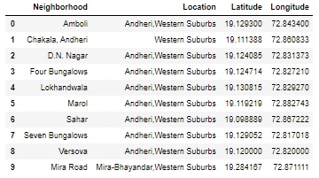
Dataset for Mumbai Neighborhoods
Figure 2: First 10 rows of Mumbai Neighbourhood Data frame

Slide 5
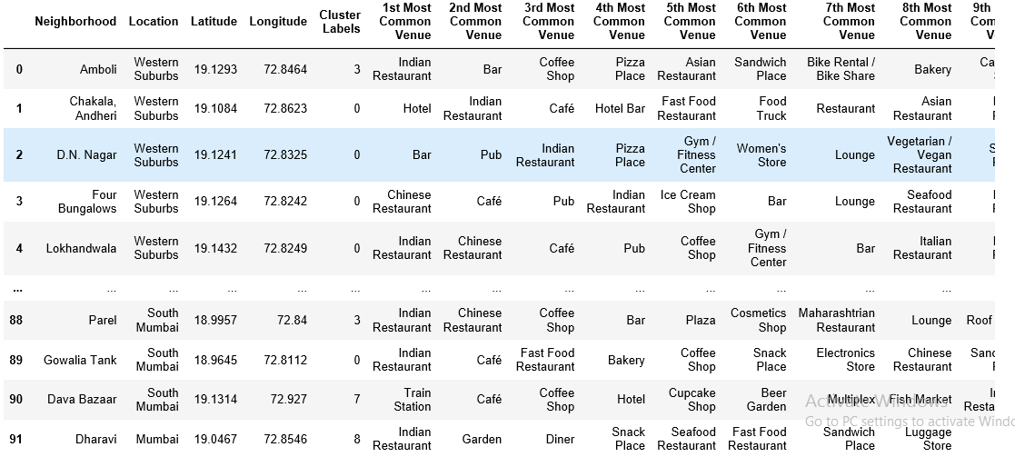
Dataset for Top 10 Most Common Venues
Figure 3: First 10 rows of top 10 most common venues for all neighbourhoods

Slide 6
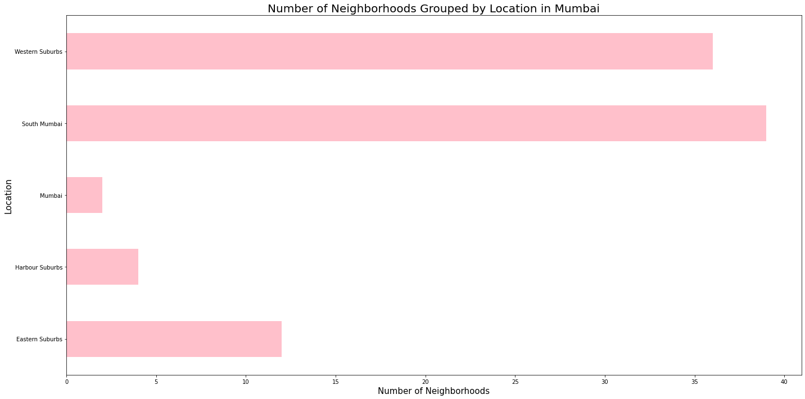
Methodology
Data Visualization
Mumbai neighborhoods data was plotted for providing a better understanding
The graph alongside depicts the number of neighborhoods in each location of Mumbai
Figure 4: Number of neighbourhoods grouped by location

Slide 7
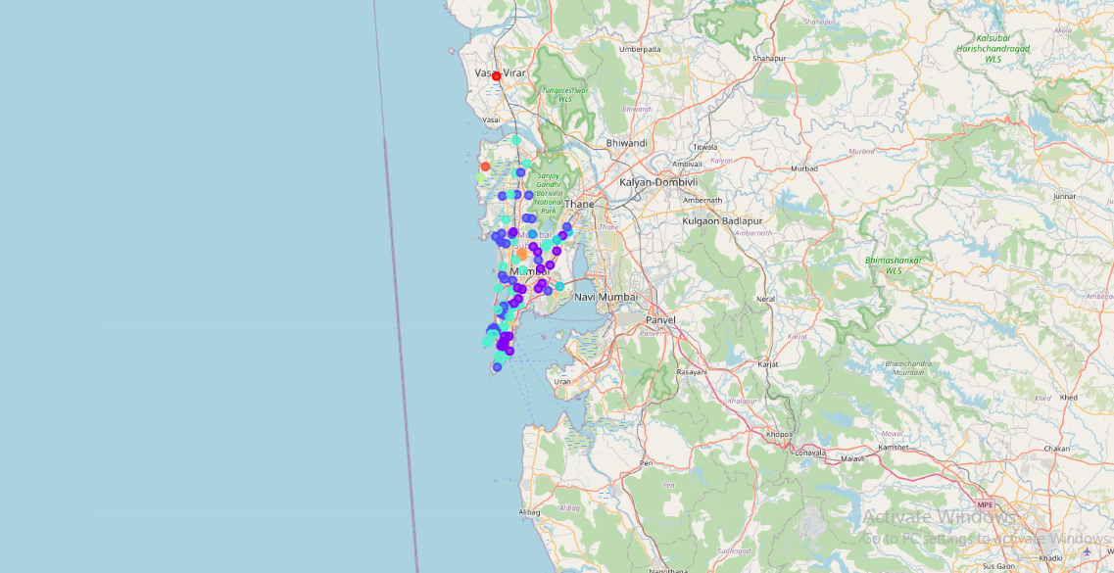
Methodology Continued
Data Visualization
The Folium library in python was used to visualize the spread of all neighborhoods across Mumbai
Figure 5: The neighbourhood spread across Mumbai

Slide 8
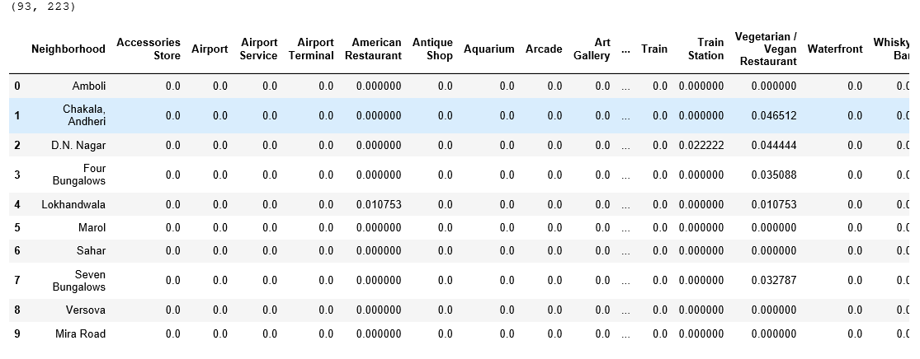
Methodology Continued
One-hot Encoding
One-hot Encoding was used to encode venue categories to numeric values with 1 if a venue belongs to a category and 0 if a venue does not belong to a category for all neighborhoods
The average is then taken for all venue categories in a neighborhood to produce the data frame shown.
Figure 6: One-hot Encoding resulting dataframe

Slide 9
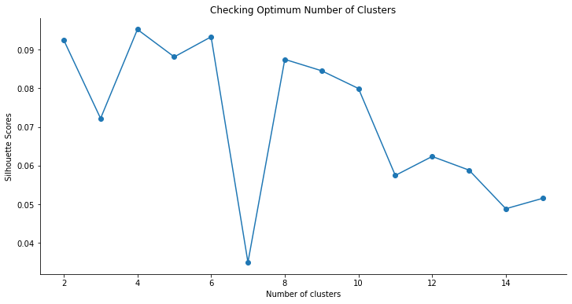
Methodology Continued
Unsupervised Learning Model
K-Means clustering was used to cluster neighborhoods in Mumbai based on venue categories
Figure 7: Silhouette scores for varying number of clusters in K-Means clustering

Slide 10
Results
Each neighborhood received a cluster label based on clustering by the K-Means algorithm
The Cluster Label column along with the Location, Latitude, and Longitude columns were added to the top 10 most common venues data frame to provide the final results
This data frame is shown on the next slide.

Slide 11
Results Continued
Figure 8: First 10 rows of clustering neighbourhoods in Mumbai data frame

Slide 12
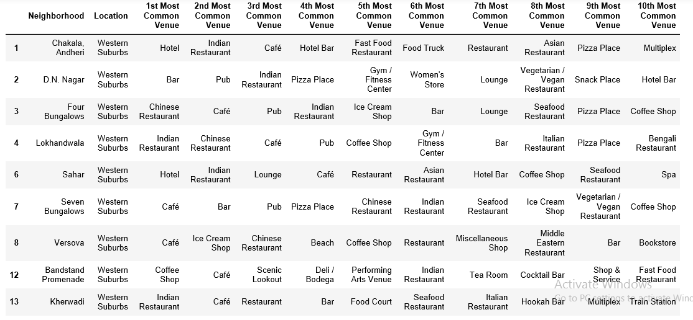
Results Continued – Cluster 1
Analyzing each cluster individually
Figure 9: Cluster 1

Slide 13
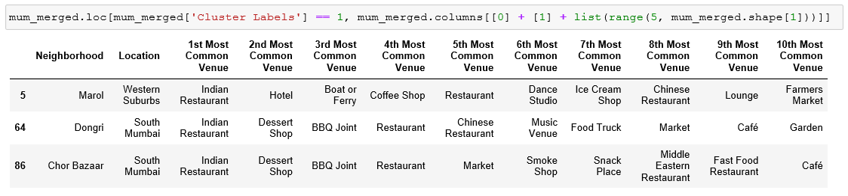
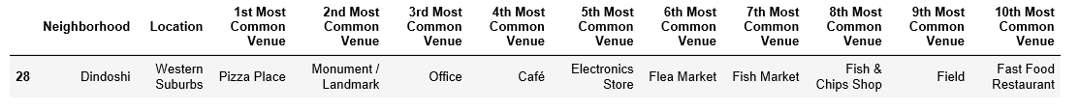
Results Continued – Cluster 2, 3
Figure 10: Cluster 2, 3

Slide 14
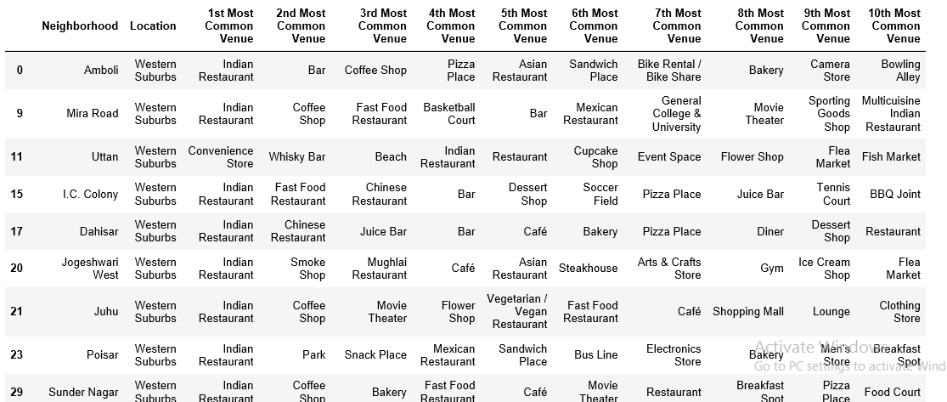
Results Continued – Cluster 4
Figure 11: Cluster 4

Slide 15
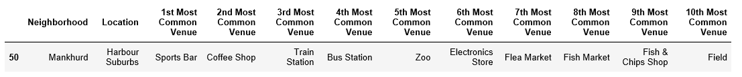
Results Continued – Cluster 5
Figure 12: Cluster 5

Slide 16
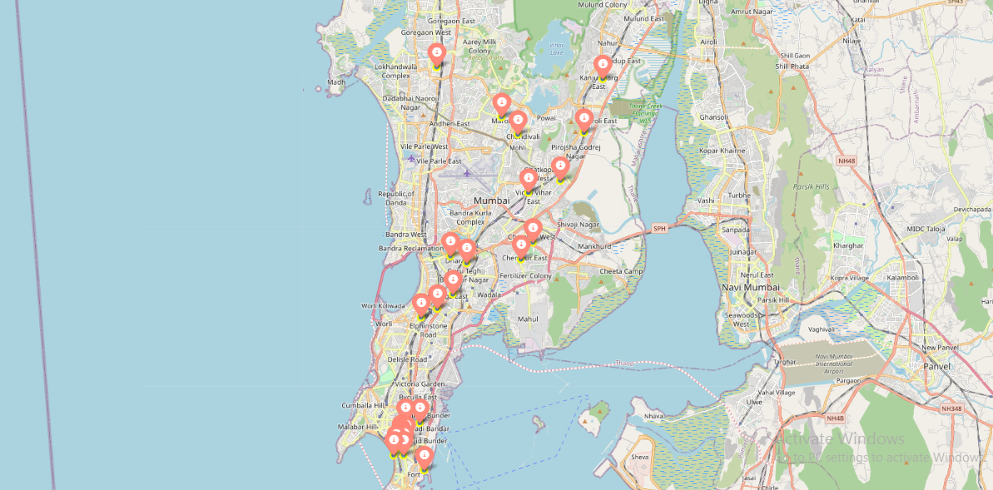
Results Continued
Visualization of neighborhood clusters was done using Folium in python
Different clusters correspond to different colors
Figure 13: Visualizing the clustering of neighbourhoods in Mumbai

Slide 17
Discussion
From my analyzing of the five clusters obtained, it is observed that cluster 1 has a high degree of hotels, bars, Chinese restaurants, cafes, Indian restaurants, clothing stores, etc. in its top 10 most common venues.
Cluster 2 has mainly Indian restaurants in its first most common venue. Cluster 3 has pizza place in its first most common venue.
Cluster 4 has mainly Indian restaurants in its first most common venue.
Cluster 5 has sports bar in its first most common venue.
From these analyses, since most neighborhoods in cluster 4 seem to have Indian Restaurant as their top most common venue; it is recommended that the new restaurant can be opened in the neighborhoods belonging to cluster 4 since it looks best suited for the purpose of starting a new restaurant.

Slide 18
Conclusion
In this project, the neighbourhoods in Mumbai, India have been successfully analysed for determining which would be the best neighbourhoods for opening a new restaurant
Based on the analysis carried out, neighbourhoods in cluster 4 are recommended as locations for the new restaurant
The stakeholders and investors can further tune this by considering various other factors like transport, legal requirements, and costs associated which were out of the scope for this project and thus were not considered.

